Slide 1
A New Theoretical Basis for Describing Low Turbulence Wind Turbine Performance
Peter Stuart
PCWG Meeting – 15 September 2015

Slide 2
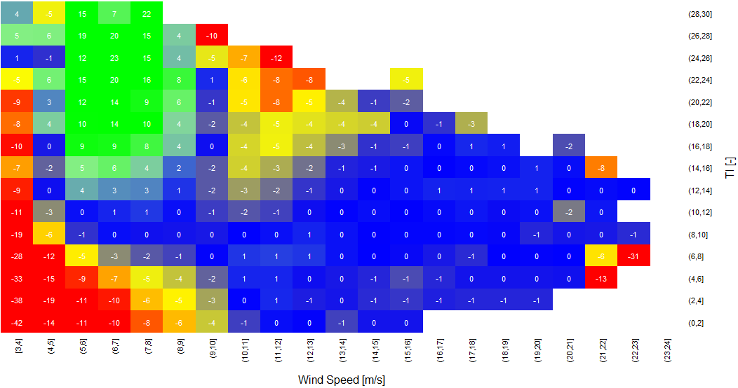

Introduction
Observed wind turbine performance
Existing correction methods (REWS and IEC Turbulence Correction) do not fully describe behaviour at low/medium wind speeds and low turbulence.
Measured Power Deviation Matrix: Deviation vs TI and Wind Speed

Slide 3
How do we look at things today?
Height
Wind Speed
Input Energy: Described by wind profile (REWS) and density.
Conversion Energy: Described by power curve (+ corrections)
Also IEC Turbulence Correction describes ‘apparent’ changes in efficiency due to temporal averaging.

Slide 4
Existing Performance Loss Classicisation
PCWG statement: Corrections should be applied for ‘real world’ conditions which are different to those for which a power curve is representative. These corrections fall into two categories:
Type A: Adjustments made to reflect changes in the kinetic energy available for conversion across the rotor in a ten minute period due to ‘outer-range conditions’.
Type B: Adjustments made to reflect changes in the conversion efficiency due to ‘outer-range conditions’.
Available Energy (the atmosphere)
Conversion Efficiency (Turbine Behaviour)
What if there is a loss mechanism which does not fit into either of these categories?

Slide 5
Back to Axial Flow Theory
According to axial flow theory in order for a wind turbine to produce power the wind must slow down both upwind and downwind of the turbine.
According to the continuity equation the streamtube must expand vertically and/or horizontally in order for the wind to slow down.
Consider a parcel of air (green box)…

Slide 6
Back to Axial Flow Theory
The ‘energy content’ of the parcel of air is described by its (instantaneous) velocity and density.
However the degree to which this energy can be extract is influenced by the ‘expandability’ of the parcel
Upwind
Downwind
A stable boundary layer (associated with low turbulence) will serve to inhibit vertical expansion

Slide 7
Stable Boundary Layer
In a stable atmosphere the temperature profile sets up buoyancy forces (blue arrows) which act to supress vertical motion.
Warm
Height
Cold
Upwind
Downwind
Temperature
The requirement of the flow to perform work against these buoyancy forces (in order to achieve power extraction) implies a turbine loss

Slide 8
Cause and Effect
The buoyancy forces act to reduce the turbulence and increase the vertical wind speed gradient (wind shear)
Two effects with the same cause…
The buoyancy forces act against the expansion required to achieve power production (thereby inducing a loss)
…which is why proxy methods based on turbulence work reasonably well.
Warm
Height
Height
Cold
Temperature
Wind Speed

Slide 9
Where to from here?
The ideas presented here need to be further developed by establishing mathematical formulation prepared.
A new parameter/metric needs to be designed which describes the expandability of the flow (stability dependent) which can be used in complement with REWS.
These ideas need to be tested against real data e.g. future PCWG haring initiatives.
Collaboration on all of the above is invited from PCWG members.

